Slide 1
Substitution: chlorine
add PCl₃
3C₂H₅OH + PCl₃ → 3C₂H₅Cl + H₃PO₃
add PCl₅
C₂H₅OH + PCl₅ → C₂H₅Cl + POCl₃ + HCl
add SOCl₂
C₂H₅OH + SOCl₂ → C₂H₅Cl + SO₂ + HCl
With tertiary alcohols:
(CH₃)₃COH + HCl → CH₃)₃CCl + H₂O
add concentrated HCl
(very slow rate of reaction with primary and secondary)
HEAT
white steamy fumes
Notes:
Guided Practice – step by step
Explanations, deconstruction
(Do not rush through guided practice)

Slide 2
Substitution: chlorine
Conc. H₂SO₄
C₂H₅OH + KCl → C₂H₅Cl + KHSO₄ + H₂O
Alcohols will not react with nonacidic NaCl, NaBr, or NaI and so the reaction must be catalysed with either concentrated sulfuric (H₂SO₄) or phosphoric acid (H₃PO₄).
Notes:
Guided Practice – step by step
Explanations, deconstruction
(Do not rush through guided practice)

Slide 3
Substitution: bromine
C₂H₅OH + HBr → C₂H₅Br + H₂O
Either hydrobromic acid is used or generated with a 50/50% mix of NaBr and conc^{n} H₂SO₄ which generates the HBr
2NaBr + H₂SO₄ → 2HBr + Na₂SO₄
3C₂H₅OH + PBr₃ → 3C₂H₅Br + P(OH)₃
Phosphorus trihalide is generated from its elements:
2P + 3Br₂ → 2PBr₃
Notes:
Guided Practice – step by step
Explanations, deconstruction
(Do not rush through guided practice)

Slide 4
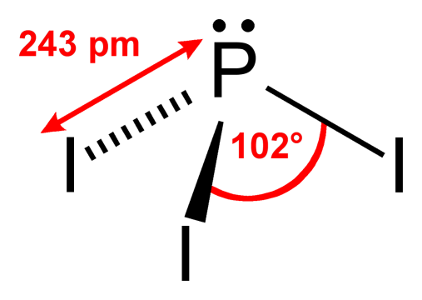
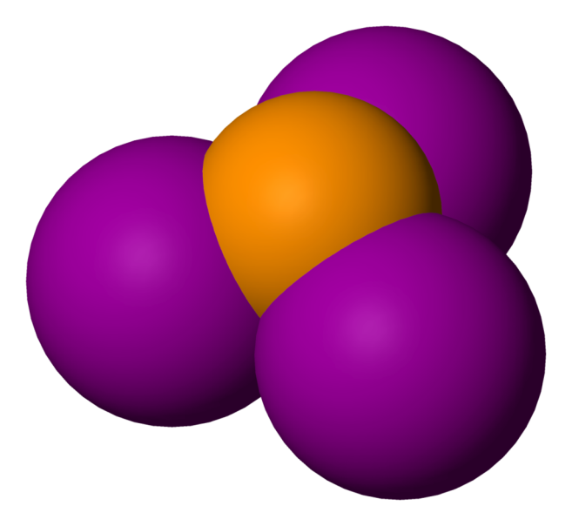
Substitution: iodine
3C₂H₅OH + PI₃ → 3C₂H₅I + P(OH)₃
Phosphorus trihalide is generated from its elements:
2P + 3I₂ → 2PI₃
Notes:
Guided Practice – step by step
Explanations, deconstruction
(Do not rush through guided practice)
------
By Benjah-bmm27 - Own work, Public Domain, https://commons.wikimedia.org/w/index.php?curid=1427817
By Benjah-bmm27 - Own work, Public Domain, https://commons.wikimedia.org/w/index.php?curid=1426265

