Slide 1
AS Presentations Sample
Notes:
Welcome from ChemCatalyst.co.uk!

Slide 2
Welcome
Thank you for downloading the sample presentation
On the slides that follow, please find examples of the different types of content which ChemCatalyst presentations include
ChemCatalyst presentations are available for the entire AQA, EdExcel and CIE AS Chemistry course

Slide 3
Custom Animation

Slide 4
Electrons fill up these orbitals in order from lowest to highest energy
energy
ORBITALS
4d
4p
3d
4s
3p (18)
3s
2p
(8)
2s
1s (2)
QUANTUM
NUMBERS
4
3
2
1
Notes:
Guided Practice – step by step
Explanations, modelling, deconstruction
(Do not rush through guided practice)

Slide 5
Conceptual Understanding

Slide 6
Do you understand ionic and covalent bonding?
“N₂ and CO are ISOELECTRONIC”
In pairs or small groups draw out dot and cross diagrams for these two molecules
Remember that all atoms are made of the same basic sub-atomic units (protons, neutrons and electrons)
Use this information to guess what the term ISOELECTRONIC means
Words like: isosceles, isotope, isomer may also help you.
Notes:
Can students conceptualise their understanding?
Connections, expansions, extended abstract thinking
(What resources are available for further student exploration?)

Slide 7
Embedded Original .gifs

Slide 8
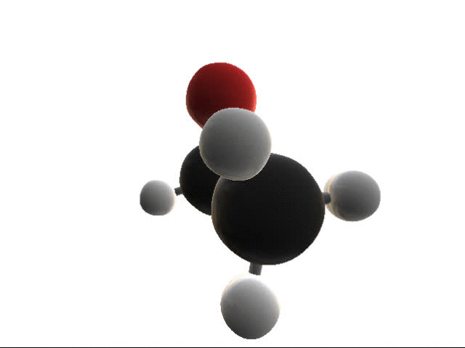
Many shapes in a single molecule
Ethanol is the chemical name for the alcohol in drinks such as wine
You can see tetrahedral shape around the carbon atoms
The ‘red’ oxygen atom has a non-linear or bent configuration
Notes:
Can students conceptualise their understanding?
Connections, expansions, extended abstract thinking
(What resources are available for further student exploration?)
.gif created with Chemitorium

Slide 9
Original Illustrations

Slide 10
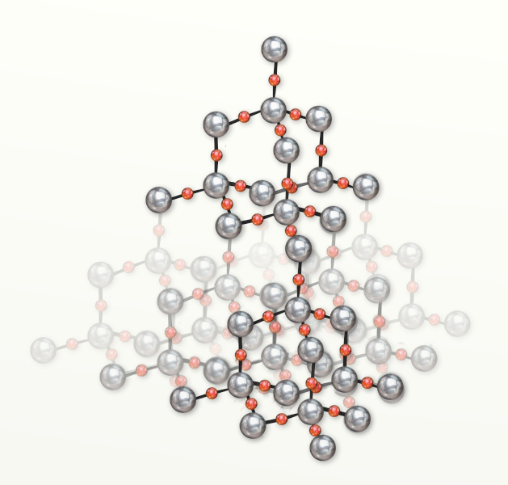
3. Giant molecular – silicon dioxide
The structure of SiO₂ is very similar to diamond
However in between each pair of silicon atoms you will find an oxygen atom
Notes:
Guided Practice – step by step
Explanations, modelling
(Do not rush through guided practice)
-------

Slide 11
Engaging class activities

Slide 12
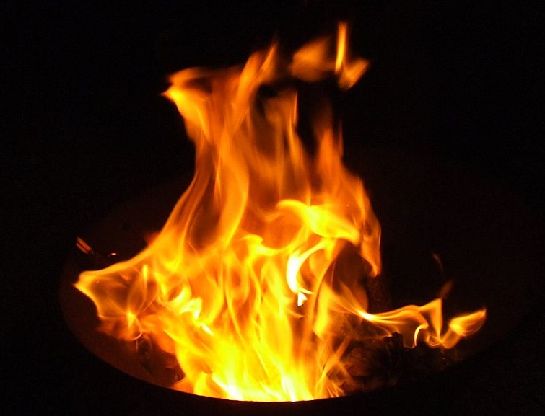
Quick fire!
123FHOC
What is the oxidation number of the element in blue?
S²⁻
Cl₂O
H₂O
NH₄⁺
SO₂
Cl⁻
CO₃²⁻
Cr₂O₃
Cu₂O
CuO
SO₃
H₂S
N₂
NO₃⁻
NO₂
CrO₃
MnO₄⁻
Na
CuCl₂
NaH
Notes:
Practice to fluency – students can hold up fingers / use mini-whiteboards
Shallow → deep understanding
Guided → independent practice
Worked examples→ problem solving → interleaving/varying
80% success before moving on → live marking, regular retrieval quizzes
Do I need to re-teach?
Spaced practice
---------------
"BurningFlame0" by BobHelmut - Own work. Licensed under CC BY-SA 3.0 via Wikimedia Commons - https://commons.wikimedia.org/wiki/File:BurningFlame0.gif#/media/File:BurningFlame0.gif

Slide 13
Mastery learning

Slide 14
ChemCatalyst presentations are built with mastery learning in mind but are flexible enough to fit any teaching style.
Mastery learning insists that students must achieve a level of mastery (between 80-90%) of a topic before moving forward to the next.
If a student does not reach that level then they are given additional support in learning and reviewing the information until the work has been mastered.
All ChemCatalyst presentations are created on Microsoft PowerPoint and have the following characteristics inbuilt which develop mastery:
frequent practice questions including worked examples
lists of specific past paper questions
content delivered in small chunks
reminders for review
content spaced and interleaved to ensure learning not performance

Slide 15
Worked examples

Slide 16
Problems involving mass
To begin with we need to be able to extract the correct information from a question
Sodium chloride can be made by reacting sodium and chlorine gas.
2Na_{(s)} + Cl_{2(g)} → 2NaCl_{(s)}
What mass of sodium chloride which could be obtained from 69 g of sodium?
How many moles is 69g of sodium?
$=\frac{mass}{Ar}=\frac{69}{23}=3 mol$
Look at the stoichiometric values. 2 mol of Na produces 2 mol of NaCl
If 2 mol of Na produces 2 mol of NaCl, then 3 mol of Na produces 3 mol of NaCl.
How much mass is 3 mol of sodium chloride?
$$=n× Mr=3×58.5=175.5g$$
Notes:
Guided Practice – step by step
Explanations, deconstruction, worked examples
(Do not rush through guided practice)

Slide 17
calculating K_{c}
H₂ + I₂ ⇌ 2HI
When 0.40 mol of hydrogen gas and 0.30 mol of iodine gas are heated until equilibrium is achieved. At equilibrium the mixture contains 0.52 mol of hydrogen iodide
It is often best to draw a quick table as you are learning
Is there a problem? We don’t have a volume – how can we calculate the concentration?
This is often the case but if you don’t get a volume you won’t need it! The value V will be cancelled out in the K_{c} expression
 | H₂ | I₂ | 2HI
Moles at start | 0.4 | 0.30
Moles at eq. | (0.4-0.26) 0.14 | (0.30-0.26) 0.04 | 0.52 (2 x 0.26)
Conc.^{n} at eq. | 0.14/V | 0.04/V | 0.52/V
Notes:
Guided Practice – step by step
Explanations, modelling, worked examples
(Do not rush through guided practice)

Slide 18
Repeat practice and starter activities

Slide 19
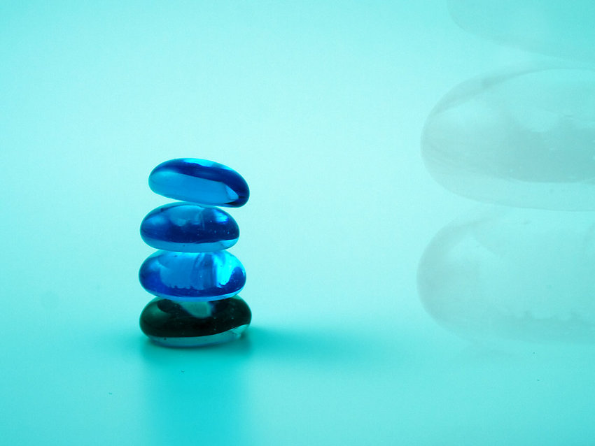
Starter 4: Balancing
Balance the following equation:
.....CoCl₂.6H₂O + ..... SOCl₂ → .....CoCl₂ + .....SO₂ + .....HCl
Notes:
As it is unlikely you will cover all of the content of an entire sub-unit in one lesson, please return to these slides at the beginning of each lesson and create/use another starter activity.
4. Answer: 1, 6, 1, 6, 12
Make connections from previous learning to new content
--------
Title:Several balancing glass pebblesBy:Petr Kratochvil (Website)
CC0 http://www.freestockphotos.biz/stockphoto/9009

Slide 20
Clear explanation

Slide 21
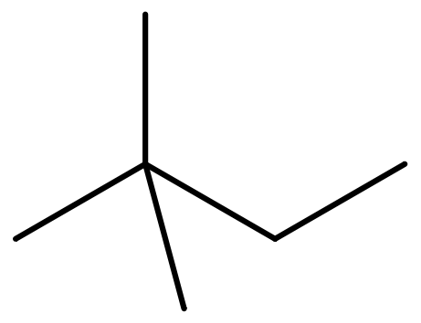
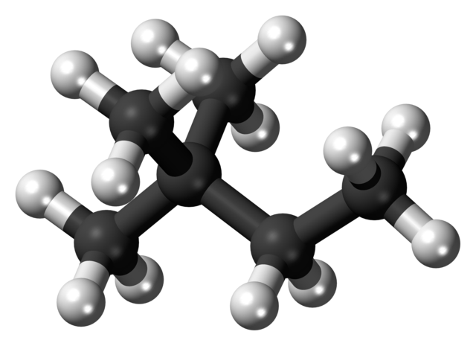
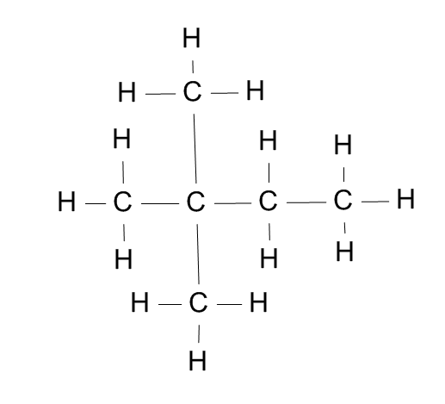
Doubling up
We use the prefixes:
di- tri- tetra-
To show multiple functional groups
2,2-dimethylbutane
CH₃C(CH₃)₂CH₂CH₃
Notes:
Guided Practice – step by step
Explanations, modelling
(Do not rush through guided practice)
-----
By Jynto (talk) - Own workThis chemical image was created with Discovery Studio Visualizer., CC0
By User Yyy on Latvian Wikipedia - Own work, CC BY-SA 3.0

Slide 22
How structure effects physical properties
Giant molecular
Melting points
Very high melting and boiling point
Strong covalent bonds acting in all directions
Conductivity: solid
DO NOT conduct electricity (graphite is an exception)
The electrons are used in covalent bonds, none are delocalised
Graphite conducts due to the layers of delocalised electrons
Conductivity: liquid
DO NOT conduct electricity
Very difficult to melt
Conductivity: aq. solution
Solubility in water
n/a
Most giant covalent structures are insoluble in water
Solubility in hexane
INSOLUBLE in polar solvents
The covalent bonds between the atoms are too strong
The covalent bonds between the atoms are too strong
INSOLUBLE in non-polar solvents
Notes:
Guided Practice – step by step
Explanations, deconstruction
(Do not rush through guided practice)
Each of these points should be worked through one at a time and expanded on with examples as needed

Slide 23
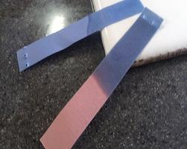
Producing ammonia
This is why I never use ammonium based fertiliser if I am treating my acidic soil with a base!
The ammonium salts can also act a source of ammonia
When competing with stronger bases the hydrogen ion is lost and ammonia is produced
NH₄Cl + NaOH → NaCl + NH₃ + H₂O
2NH₄Cl + MgO → MgCl₂ + 2NH₃ + H₂O
Damp red litmus paper turns blue in the presence of ammonia
Notes:
Guided Practice – step by step
Explanations, deconstruction
(Do not rush through guided practice)
------
http://www.easynotecards.com/print_cards/31740

Slide 24
Homework and independent study skills

Slide 25
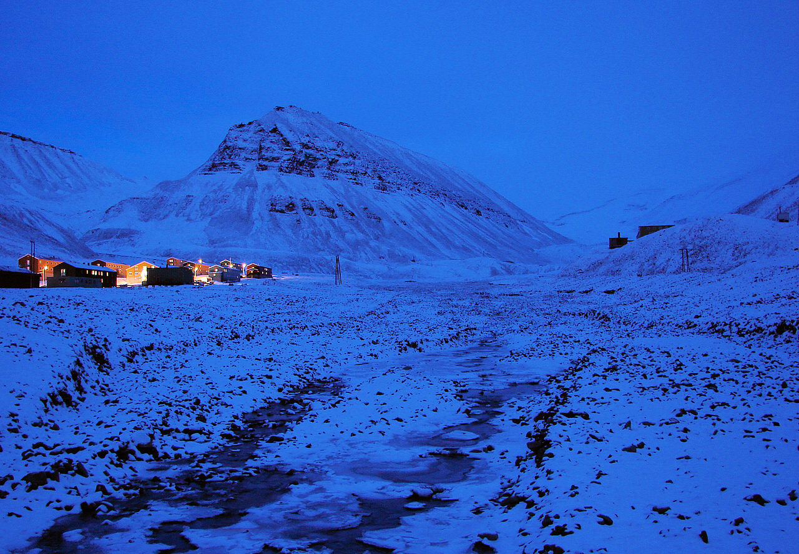
Research Homework
Carbon dioxide levels in the air increase at night-time and also increase during winter compared to summer
Research and explain these two phenomena
Notes:
Homework for fluency, expansion or connection – insert homework as your lessons progress.
“Plan for fluent & permanent learning”
---------
"Polar-Night Longyearbyen" by Bjørn Christian Tørrissen - Own work by uploader, http://bjornfree.com/galleries.html. Licensed under CC BY-SA 3.0 via Commons - https://commons.wikimedia.org/wiki/File:Polar-Night_Longyearbyen.jpg#/media/File:Polar-Night_Longyearbyen.jpg

Slide 26
Organic mechanisms

Slide 27
Mechanism
This is another nucleophilic addition
The CN⁻ ion acts as a nucleophile attacking the delta positive carbon attached to the oxygen in the carbonyl
⁺
δ⁻
-
δ⁺
-
⁺
δ⁻
-
δ⁺
-
what is special about this carbon?
Name the reactants and products
Notes:
Guided Practice – step by step
Explanations, deconstruction, worked examples
(Do not rush through guided practice)

Slide 28
Practice to fluency

Slide 29
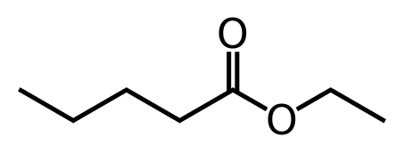
Displayed formulae
How many esters have the following molecular formula C₄H₈O₂?
Draw displayed formulae and name them
Ethyl pentanoate has a pleasant aroma and taste. It is used as a food additive to impart a fruity flavour, particularly of apple.
Notes:
Practice to fluency
Shallow → deep understanding
Guided → independent practice
Worked examples→ problem solving → interleaving/varying
80% success before moving on → live marking, regular retrieval quizzes
Do I need to re-teach?
Spaced practice
------
By Benrr101 - Own work, Public Domain, https://commons.wikimedia.org/w/index.php?curid=18003556

Slide 30
Checks for understanding

Slide 31
Check for understanding
100
50
0
Transmittance %
3000 2000 1500 1000 500
Wavenumber ⁻¹
Which spectra RED or BLACK shows the presence of a nitrile group?
Notes:
Defend, disagree, summarise

Slide 32
Isotopes and ions
Student A declares,
“The proton number is the most important piece of information when identifying an atom or an ion”
Student B disagrees,
“The number of neutrons and electrons are most important as this tells us whether we have an ion or an isotope”
Who do you agree with?
Notes:
Check for understanding
Self-explanation, expand, defend, disagree, summarise
In an atom of a specific element the number of neutrons can vary as can the number electrons. The proton number dictates the element.

Slide 33
Plenary activities

Slide 34
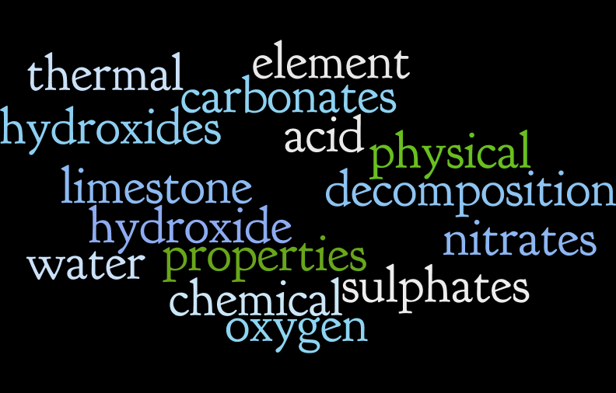
Create 5 summary sentences using the words below to help you
Notes:
Summary plenary/activity
How will you ensure your students are over-learning by 20% for fluency & permanence?
Where are they now? Adjust accordingly.
Wordle.net

Slide 35
Original video

Slide 36
Soluble carbonate + acid
Imagine you just opened a bottle of lemonade

Slide 37
Specific past paper questions

Slide 38
Past paper questions
Paper 1, June 2003, Q25
Paper 1, June 2003, Q22
Paper 1, Nov 2007, Q24
Paper 21, Nov 2013, Q2
Paper 11, Nov 2014, Q20
Paper 41, June 2015, Q7b
Paper 13, Nov 2013, Q23
Paper 43, Nov 2013, Q5 (a)(ii) (b)
Notes:
Practice to fluency
Shallow → deep understanding
Guided → independent practice
Worked examples→ problem solving → interleaving/varying
80% success before moving on → live marking, regular retrieval quizzes
Do I need to re-teach?
Spaced practice

Slide 39
SRQ Worksheets
ChemCatalyst also has entire sets of Spaced Repetition Questions (with worked answers) for each syllabus
SRQ Worksheets are designed to stagger and plan questions to automate revision, test and extended knowledge, and maximise learning effects.

Slide 40
18+ worksheets per board

Slide 41
Visit chemcatalyst.co.uk for more information
also available on TES.com

